Slide 1

Unified Functional Testing
A Full Stack Testing Approach
Biswajit Das @ Full Stack Test Automation Engineer
Notes:
To use this title animation slide with a new image simply 1) move the top semi-transparent shape to the side, 2) delete placeholder image, 3) click on the picture icon to add a new picture, 4) Move semi-transparent shape back to original position, 5) Update text on slide.

Slide 2
Agenda
We will go over together how to bridge the technology gap between front end and service layer testing with Micro Focus Unified Functional Testing (formerly HPE UFT) tool set.

Slide 3
Tech Stack
UFT GUI & API Module
Swagger 2.0
Json2C# Class Generator
Visual Studio /Code
COM DLL

Slide 4
Quick Poll
Let’s do a quick poll to visualize how relevant be our discussion would be?

Slide 5
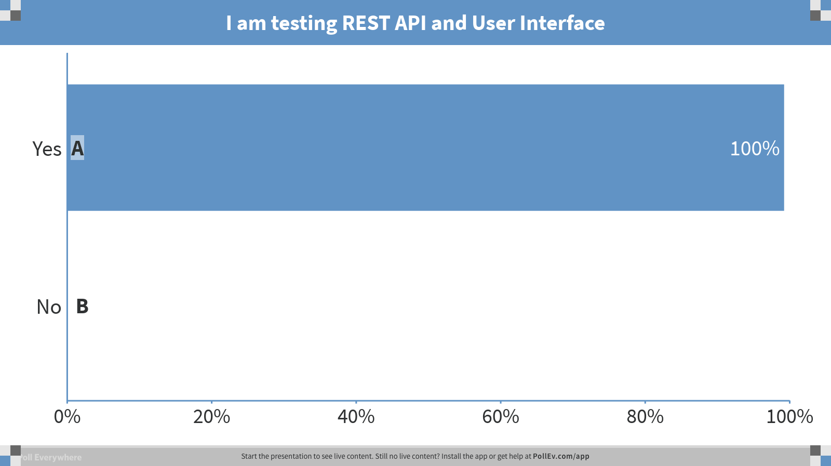
Notes:
Poll Title: I am testing REST API and User Interface https://www.polleverywhere.com/multiple_choice_polls/luJIAt10aDg1iZz

Slide 6
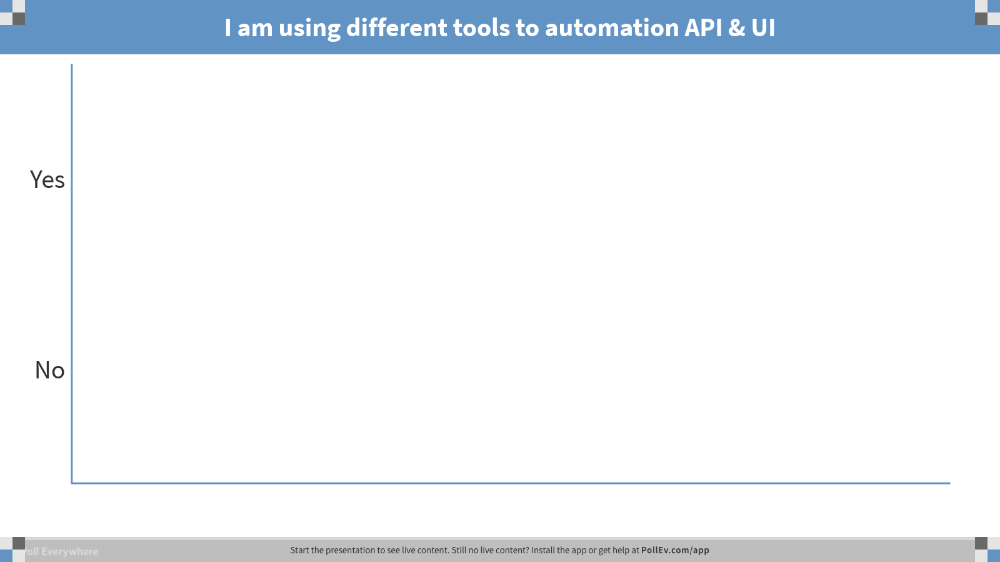
Notes:
Poll Title: I am using different tools to automation API & UI https://www.polleverywhere.com/multiple_choice_polls/tTo0dQyNlDZdc4o

Slide 7
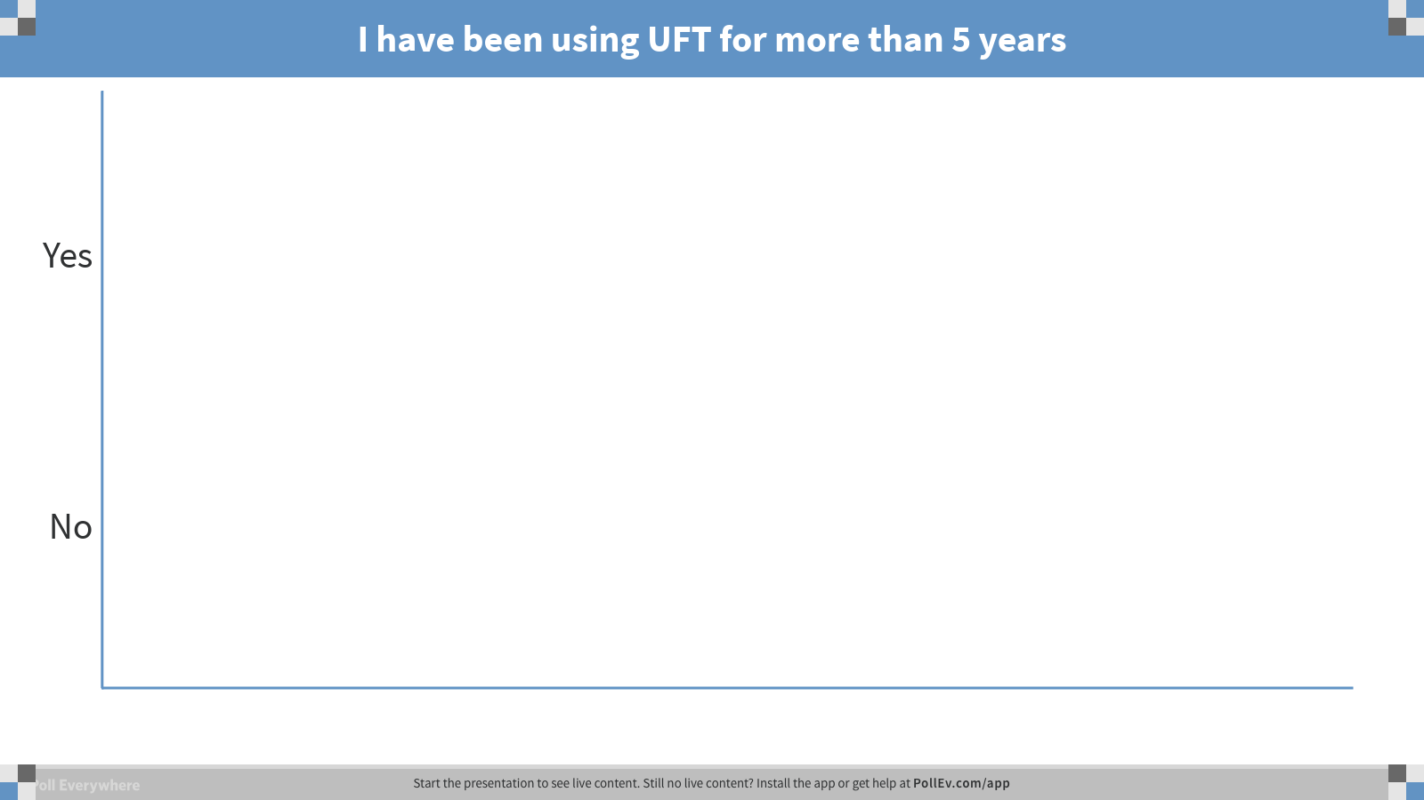
Notes:
Poll Title: I have been using UFT for more than 5 years https://www.polleverywhere.com/multiple_choice_polls/EOMU0ivZsvWH4ex

Slide 8
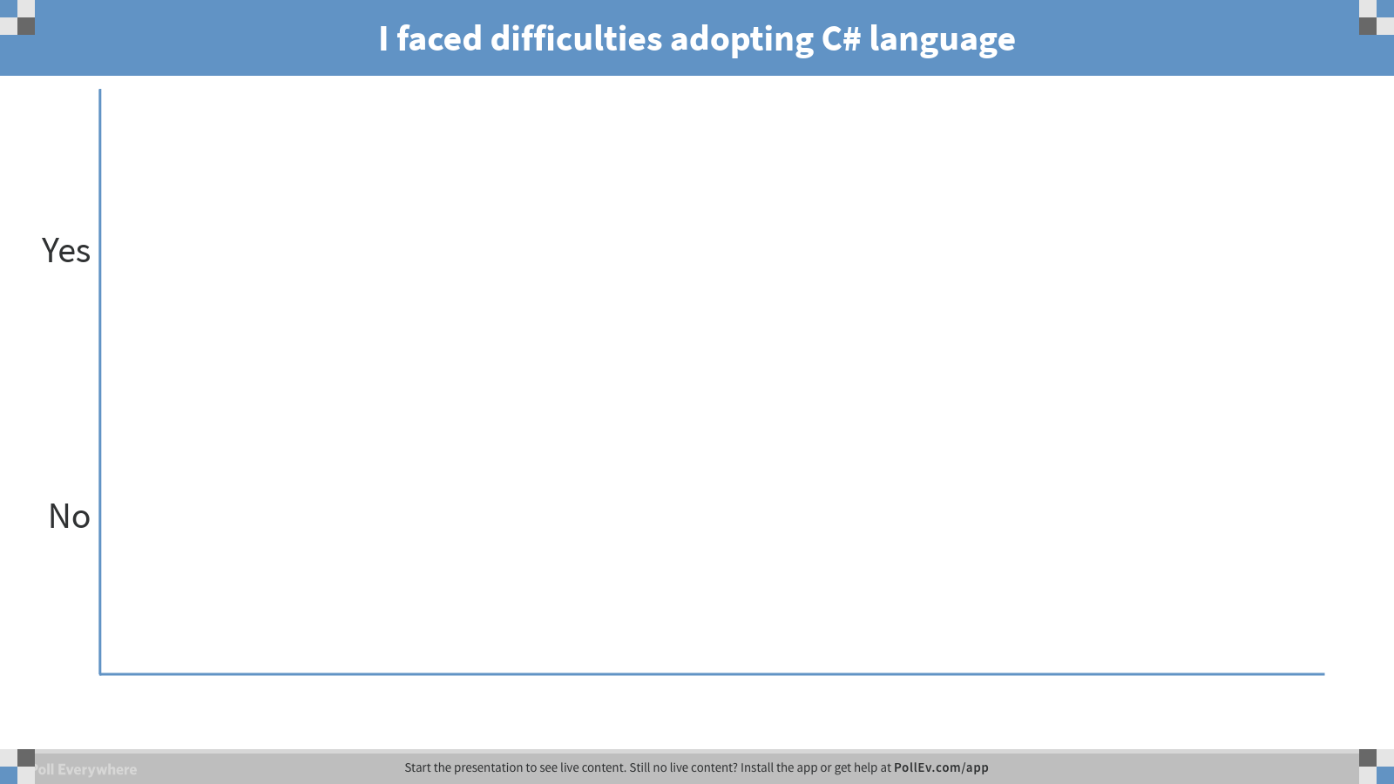
Notes:
Poll Title: I faced difficulties adopting C# language https://www.polleverywhere.com/multiple_choice_polls/nD5xlfxIlDyyuSV

Slide 9
REST Project
Swagger Petstore 1.0.0
http://petstore.swagger.io/
pet - Everything about your Pets
Post -/pet Add
store – Access to Petstore orders
user - Operations about user

Slide 10



How?
Component
getPetByIdApi

Slide 11

See it in Action

Slide 12




References
http://petstore.swagger.io/#/user
http://jsonclassgenerator.codeplex.com/
https://community.softwaregrp.com/t5/Quality-and-Testing-Blog/HPE-UFT-now-enables-the-creation-of-API-tests-for-Swagger/ba-p/219380#.WoYGi6jwaHs
4.
to.biswajit.das
tobiswajitdas
in/biswajitdas
in/biswajitdas

Slide 13

Questions?

Slide 14
Thank You!
“What feels like the End is often the Beginning”
to.biswajit.das
tobiswajitdas
in/biswajitdas
in/biswajitdas

Slide 15
VISUALS ADD A COMPONENT TO STORYTELLING THAT TEXT CANNOT | SPEED.
MSQAG
Images are another element that can drive your point home even more

Slide 16
1
Understand your brand and audience; speak in an authentic voice
PREPARE
Why does this matter to your audience?
Where are you taking them?

Slide 17
2
Get your facts straight with 5 W’s
DEFINE
Who | What | Where | When | Why

Slide 18
3
Images are a great tool for showing context
SUPPORT
We perceive the world through more than our eyes and ears; we smell, we touch, and we taste.
Put your audience in that place and provide them a point of reference; the imagination will do the rest.
Notes:
Tip:
When using complex image as full-bleed background add a transparency (70%-90%) fill layer to give contrast to text.

Slide 19
4
Show, don’t tell
ENGAGE
Visualize key messages
A picture is worth a thousand words…
Make a statement
Using graphics, charts, and infographics

Slide 20
5
Know the end at the beginning
LEAD
Start your story with an outline, a framework of points you need to have to tell your story, always moving forward to the conclusion or action points

Slide 21
TAKEAWAY
What do you want them to remember?
INSPIRE
Get them excited about what’s to come
ACTION
Build your presentation and give us your feedback if this was helpful to you.
Notes:
Combine an image and multiple key statements with a strong grid.

Slide 22
BECAUSE STORYTELLING, AND VISUAL STORYTELLING, WAS PUT IN THE HANDS OF EVERYBODY,
WE HAVE ALL NOW BECOME STORYTELLERS.
—LEVAR BURTON

Slide 23
POWERFUL PRESENTATIONS!
THANK YOU

